Slide 1
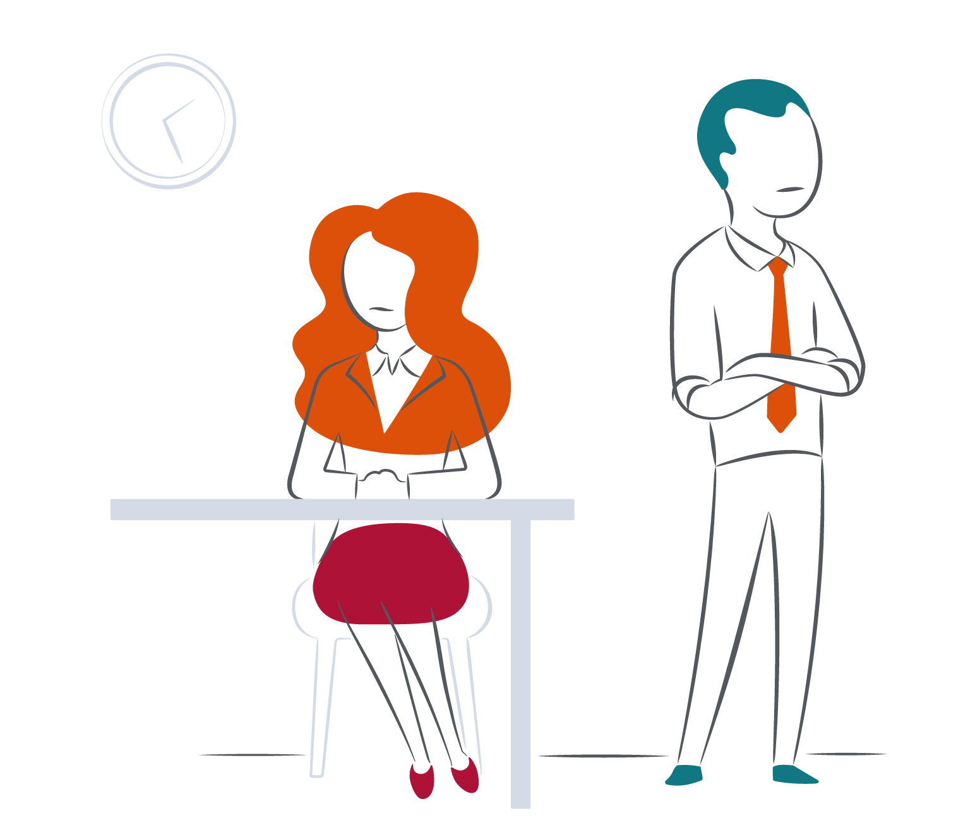
Normalizing constructive conflict

Slide 2
Pre-session reflection prompts
What is your typical approach to dealing with conflict?
What examples do you have of where any of the Your Strengths in Managing Conflict in your PIR have shown up?
What behavior would others observe in you when you’re dealing with conflict?
What examples of differences in dealing with conflict have you observed in your colleagues?

Slide 3
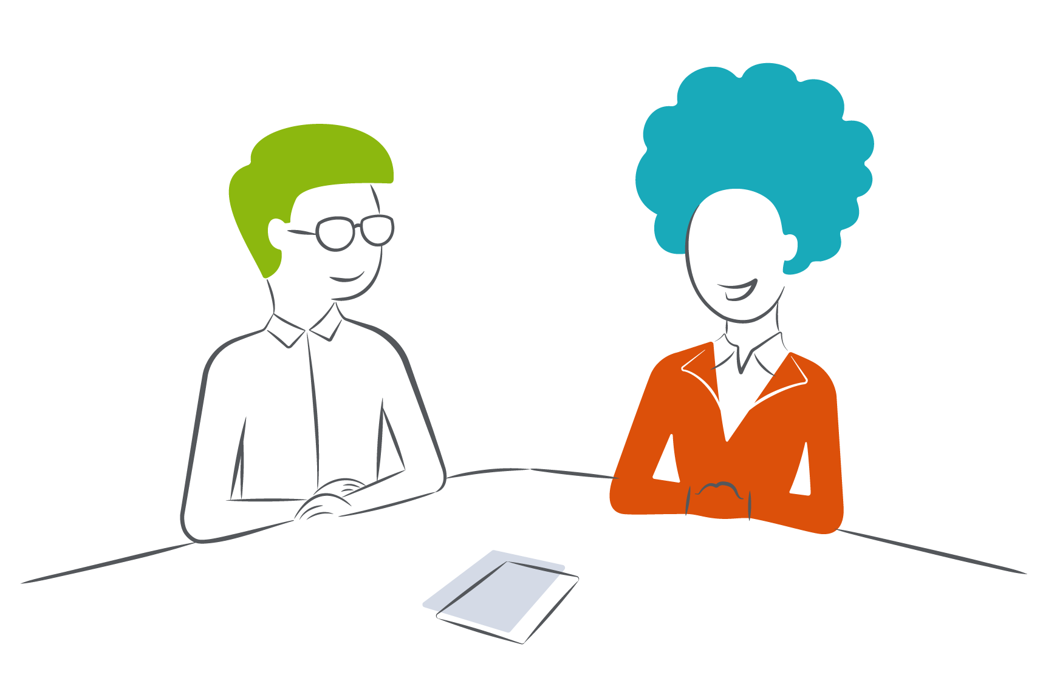
Rotating pairs exercise
Round 1: What are your strengths in managing conflict?

Slide 4
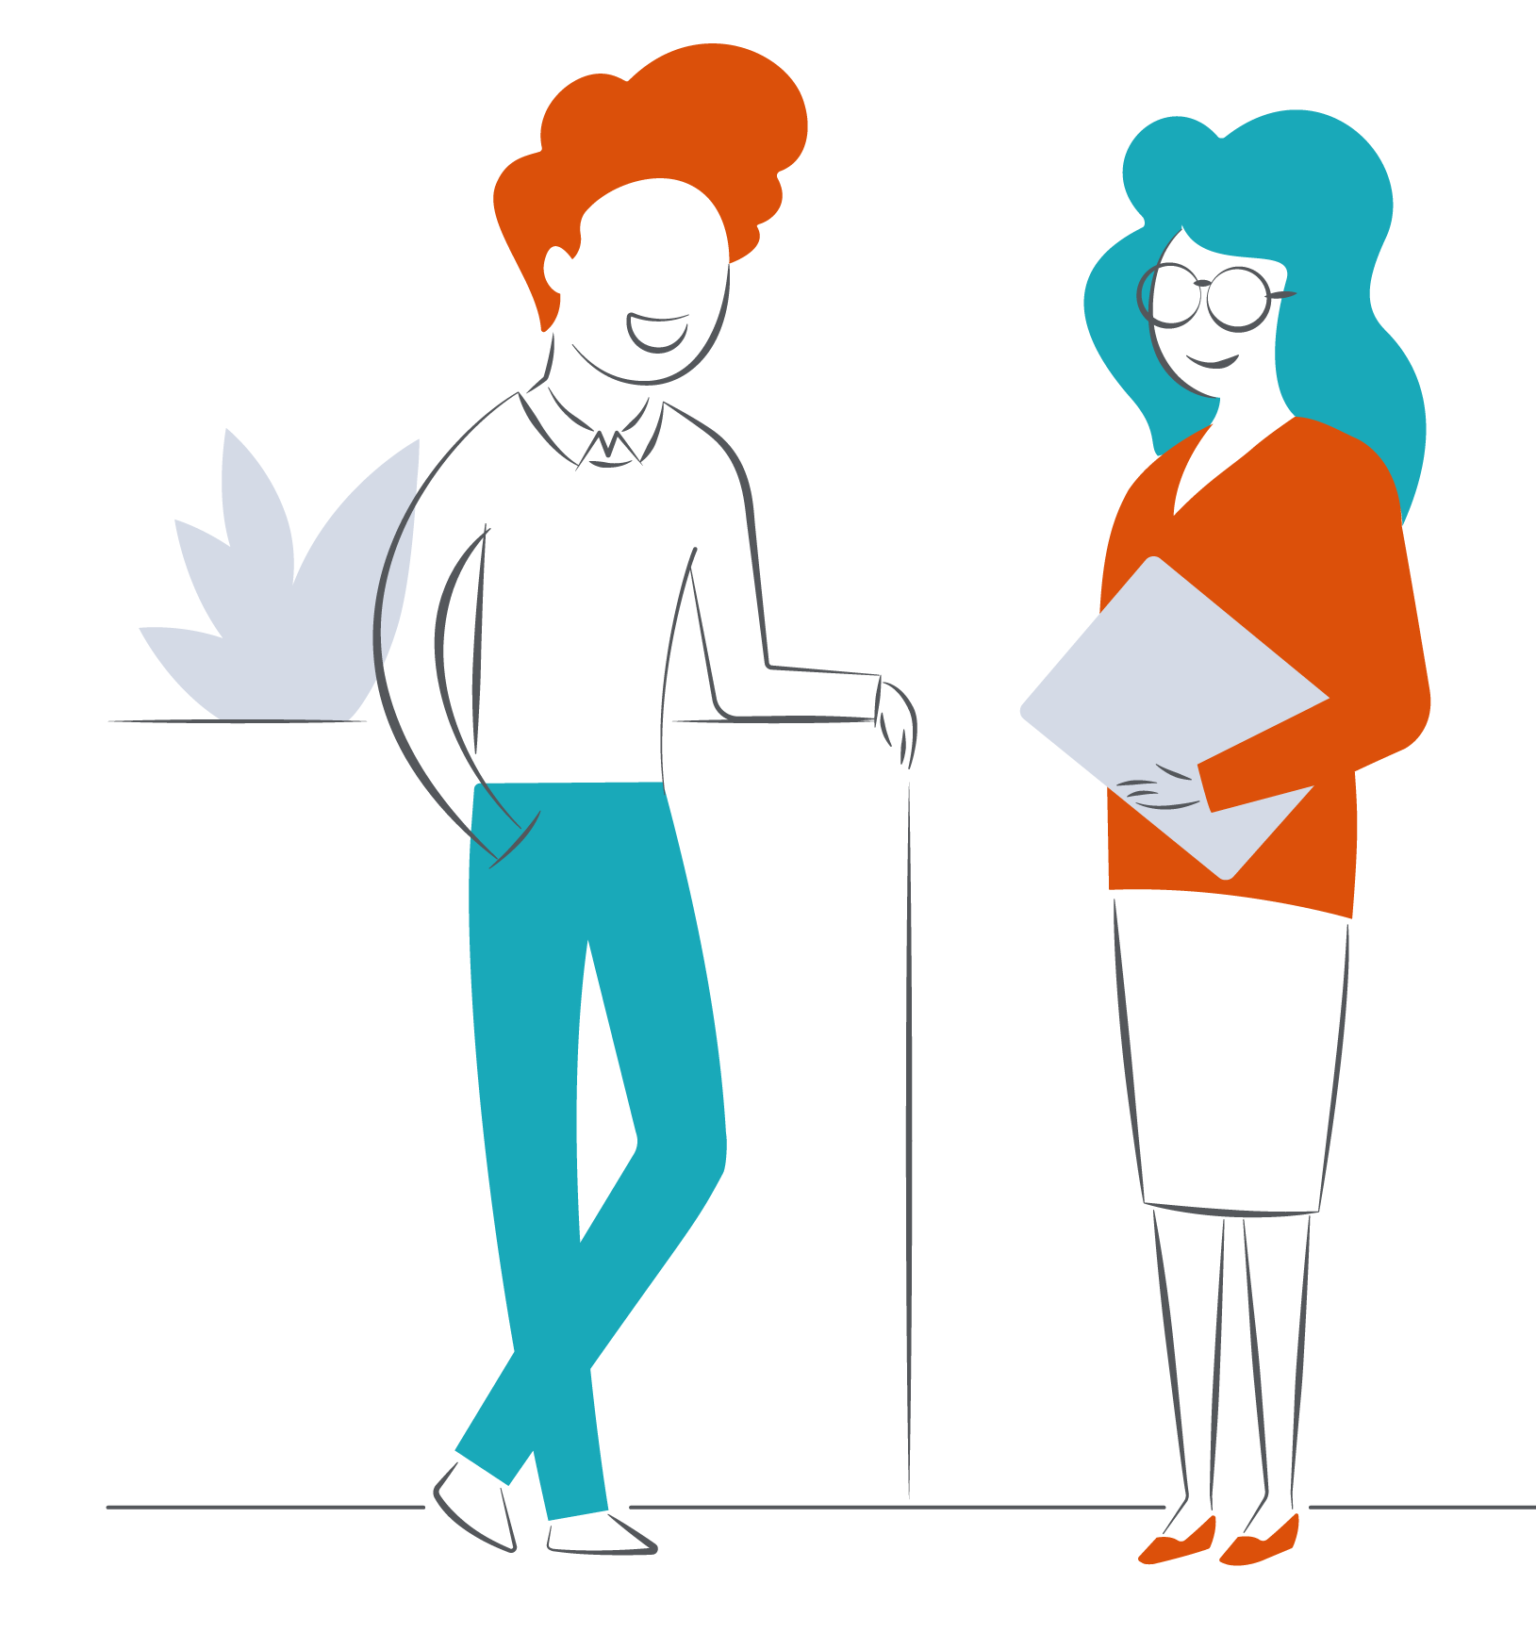
Rotating pairs exercise
Round 2: What do you need from others, and each other, when dealing with conflict?

Slide 5
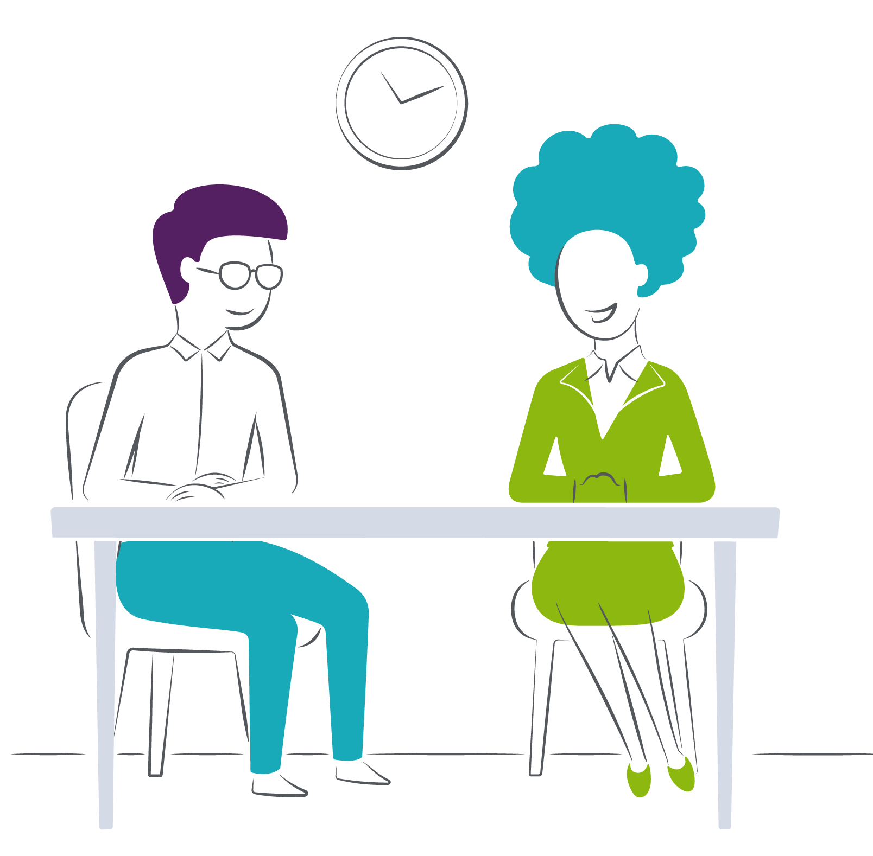
Rotating pairs exercise
Round 3: How do others tend to see you?

Slide 6

Rotating pairs exercise
Round 4: What can you do to develop your conflict style?

Slide 7
Debrief
How did you find that exercise?
What did you learn about yourself?
What did you learn about your colleagues?
How do you perceive/feel about conflict now that you’ve heard from your colleagues about their different styles?
What patterns or themes have emerged that might shed light on the team’s typical way of responding to conflict?

