Slide 1
Pre-session reflection prompts
What aspects of your natural decision-making style typically help your decision-making process?
What aspects of your style can create challenges during your decision-making process?
Think about someone you know whose decision-making style is different to yours.
Which elements of their approach to decision-making do you admire? Why?
Which aspects of their decision-making style do you find more difficult to deal with? Why?

Slide 2
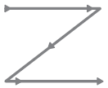
Decision-making sequence
Also known as the Z, or Zig-zag model
The model emphasises the personality type preference pairs of Sensing–Intuition and Thinking–Feeling

Slide 3
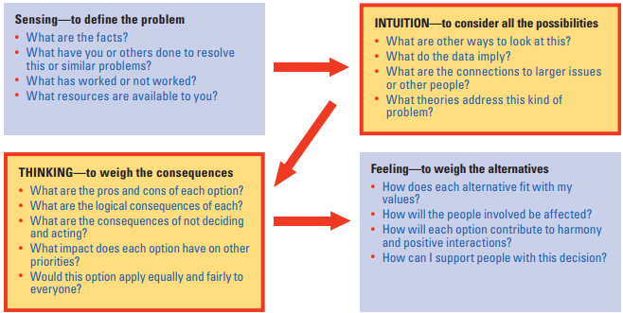
Decision-making sequence for problem-solving
10 minutes exploring the Sensing perspective
10 minutes exploring the Intuition perspective
10 minutes exploring the Thinking perspective
10 minutes exploring the Feeling perspective

Slide 4
Example debrief questions
What did you notice about your effort and energy levels and those of the group at each stage?
How did it feel systematically working through all four preferences in this way?
Which preferences were most comfortable?
Which preferences felt most difficult?
What did you notice about yourself during the exercise?
What did you notice about your colleagues?
What might all of this tell you about your team decision-making style?
What specifically do you need to do as a team to make more effective decisions together?

