Slide 1
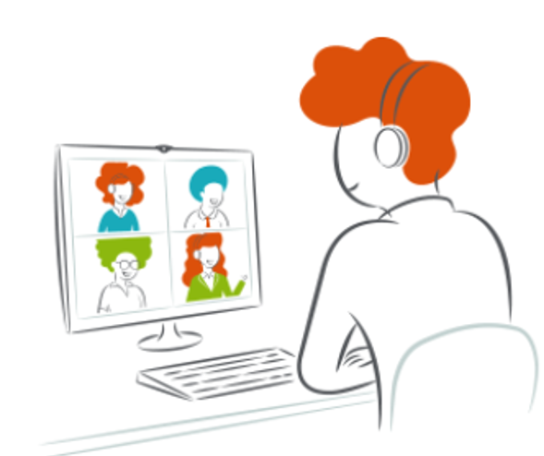
Influencing without authority.
Landing important or difficult messages.
Adapting communication style to appeal to others’ diverse styles.
Effective communication in the virtual space.

Slide 2
Opportunity to build awareness of:
How their personality preferences influence the way they communicate.
When their natural style works and when it may be less effective.
How adapting their communication style to appeal to those with different styles can help them land important or difficult messages more effectively.

Slide 3
Landing important or difficult messages
Which aspects of your communication style as outlined in your PIR, could help or hinder you when you’re trying to land an important or difficult message?

Slide 4
Actions and next steps
What actions will you take to apply your insights about your communication style?

Slide 5
Participant takeaway—try asking:
How do you prefer to be communicated with?
What do you need from me when I communicate with you?

