Slide 1
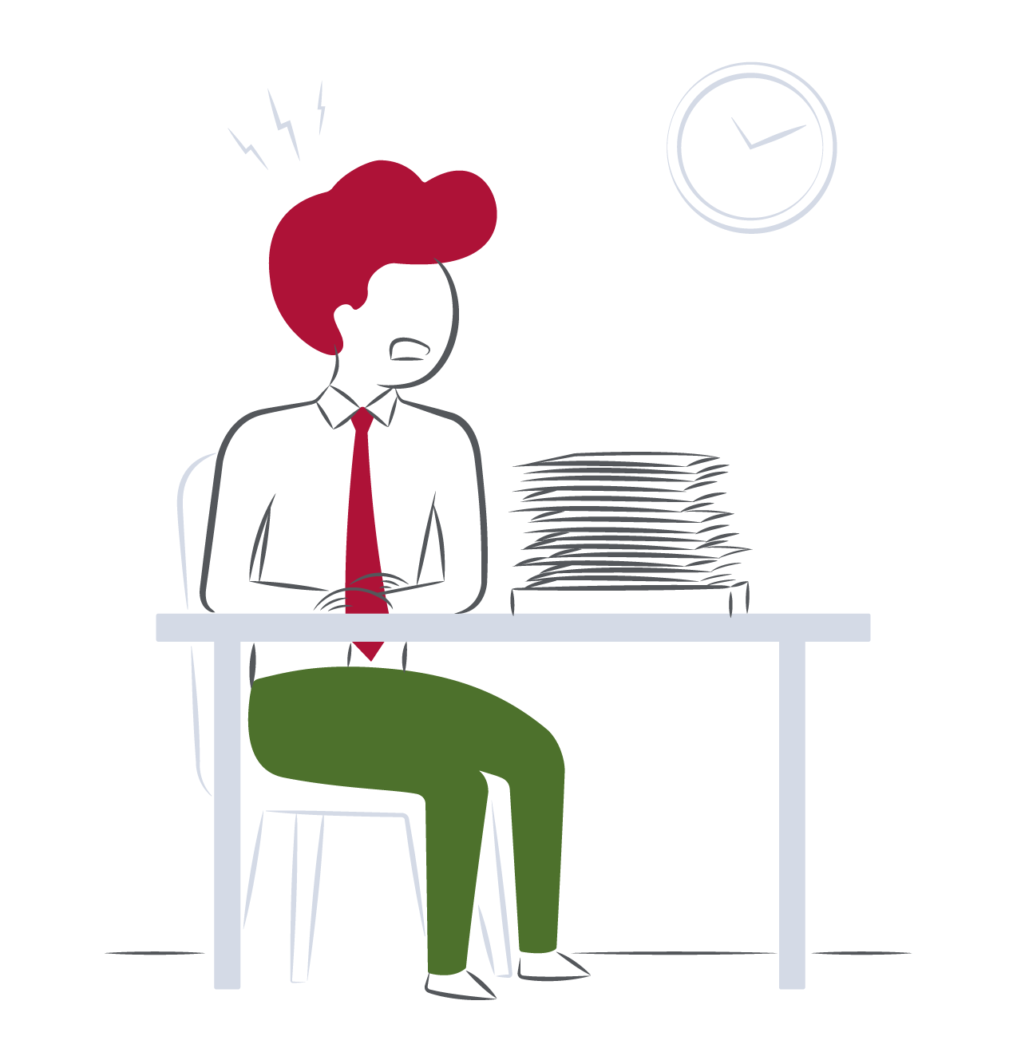
Coping with stress – so much more than dealing with a heavy workload…

Slide 2
Light bulb moments
“Oh, so that’s where that uncharacteristic behavior comes from!”
“I just didn’t realise how different other people’s stress triggers and reactions can be.”

Slide 3
Pre-session reflection prompts
What are your main stress triggers? Which of the stressors in your PIR particularly resonate for you?
What behavior would others observe in you when you’re under pressure or experiencing stress?
What would be going on for you internally that others would not see?

Slide 4
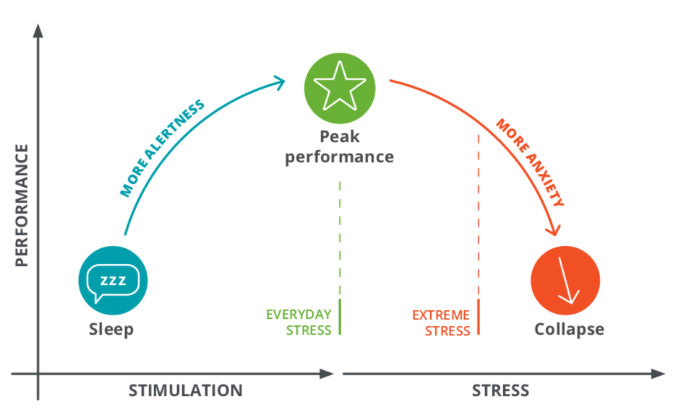
Everyday and extreme stress

Slide 5
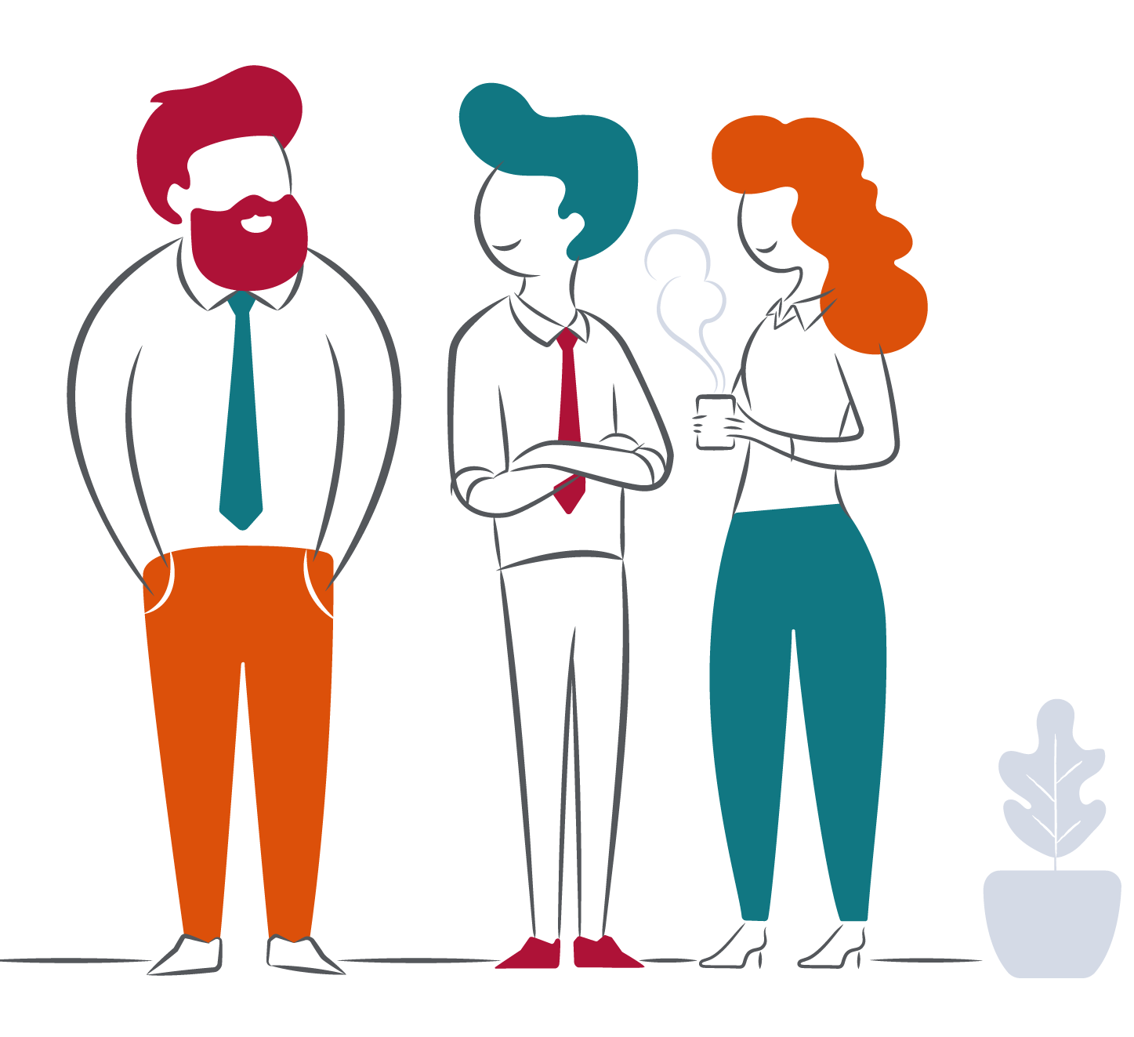
Team commitments
What are our team commitments to each other, in how we offer support to build resilience and cope with stress?
What will we do as leaders, to support our teams and the organization through this challenging time?

Slide 6
Individual action planning
Identify specific actions and next steps to take following the session.
Review the How Stress Impacts You section of PIR.
Consider which coping strategies to try out.

