Slide 1
UK Sales & Marketing 2025 H1 Plan
January 2025
Notes:
Overview of first half plans – in line with new strategy
A lot of plan get's us to Type Intelligence – ATD and FOW – intentionally only focused on H1 – post H1 new world post TI – new plan/website
Increase customer engagement
Increase reasons for sales outreach
Compliment sales efforts to reduce churn (by increasing the customer engagement for sales to follow up on)
Increase probability of sales led conversations leading to opportunity generation in Q1/Q2

Slide 2
📊Strategic focus

Slide 3
Six strategic initiatives
Notes:
Dan – today we talk about grow cert and go to market

Slide 4
Practitioner Personas for ICON customers
Strategic Priority
 | Dabblers | Coaches and Therapists | Corporate Consultants | Superstars
Description | ICONs trying out consulting as side business or second career after retirement | ICONs who help individuals address personal, nonbusiness challenges | ICONs who consult for organizations on their business challenges—our typical ICON customer | The most sophisticated and successful ICONs, who incorporate MBTI theory into their practice
Demographics and Background | 45–65 years old, skews female Often from diverse, non- HR/L&D/OD backgrounds | 35–55 years old, skews female Typical titles: coach, therapist, marriage counselor Sometimes educationally eligible to use MBTI assessment instead of being certified May be certified on competitor assessments | 35–55 years old, skews female Typical titles: consultant, executive coach, trainer/facilitator Often certified on competitor assessments | 45–55 years old, skews female Typical titles: consultant, executive coach, trainer/facilitator Usually certified on competitor assessments, with MBTI assessment often just one component of their services/solutions
Goals and Motivations | Test waters to see if consulting can lead to viable business Genuinely enthusiastic about MBTI approach and believe it can help people | Differentiate themselves in a crowded market Generate enough revenue to sustain business and livelihood | Differentiate themselves in a crowded market Generate enough revenue to sustain business and livelihood | Cultivate personal brand and be perceived as expert and thought leader Maintain/grow their business, which often includes associates and staff

Slide 5
Practitioner Personas for internal customers
Strategic Priority
 | Individual Contributors | HR Managers | L&D/OD Specialists | MBTI Champions
Description | Practitioners from HR or L&D/OD whose primary job is to deliver trainings to employees | HR professionals who are also responsible for managing employee training and development | L&D/OD professionals who specialize in designing and delivering employee training and development | HR or L&D/OD professionals who succeeded in getting their organization to embed MBTI theory within their processes and culture
Demographics and Background | 25+ years old, skews female Typical titles: trainer, facilitator, internal consultant Often started as junior HR/L&D/OD professionals and then sent for MBTI certification | 30–55 years old, skews female Typical titles: varies Usually don’t have L&D/OD background and are from smaller organizations without that function | 30–55 years old, skews female Typical titles: varies Bachelor’s or advanced degree in sociology, psychology, OD, or related fields May be certified on competitor assessments | 45–55 years old, skews female Typical titles: varies Usually in more senior roles and managing a team of practitioners; not actively delivering trainings
Goals and Motivations | Successfully deliver trainings and meet KPIs Receive recognition for their efforts (e.g., positive smile sheets, survey results, feedback from stakeholders) Not look bad while “onstage” | Ensure HR strategy is aligned to organization’s business strategy Fulfill wide range of HR responsibilities, including training and development; MBTI approach is not top of mind Seek turnkey training solutions because they lack time and expertise | Ensure their work supports their organization’s strategy and priorities Prove their own and group’s value (because their work is sometimes perceived as luxury that can be cut in difficult times) | Truly believe in MBTI theory and want to spread it to every corner of organization Continue to lead team to enhance and scale their MBTI program, delivering value to organization Maintain their status as MBTI guru

Slide 6
Strategic marketing approach for 2025
Bridge H1
Tactics focussed on highlighting PIR + soft skills for blue box practitioners including external webinars (lead gen) and the virtual user series (retention strategy)
Marketing fundamentals
Launch H2
Tactics focussed on soft and full launch of type intelligence including the ATD and FOW tradeshow plans
There will be appropriate tactics to support other brands
New Innovation

Slide 7
High Level B2B Plan
H1
H2 Launches:
Epicore to D365 support
Elevate Migration New website development
Key Projects
Type Intelligence
New website
Virtual User Series
MBTI Referral Scheme
PIR campaign
TKI webinar series
Customers
Festival of Work/ATD
PIR campaign
ZoomInfo retargeting
LinkedIn Social Engagement Strategy
Prospects
Onboarding emails
Monthly customer newsletter
Qrtly Training calendars
Digital: Adwords/SEO, social, website
DACH – DE language TKI report launch & prospect campaign
BAU & Regional
Notes:
Add in virtual user series
LinkedIn social engagement strategy
Change to H1
Launch symbols

Slide 8
New Website

Slide 9
Website
Plan is to launch the new US website 1st May with the UK site following in June/July
UK site rollout dependant on Elysium project progress
New website goals
Design a homepage that tells the story of The Myers-Briggs Company family of brands
Align the website with our business strategy, targeting L&D professionals and structuring content around the 4 phases of the practitioner journey.
Increase engagement and conversions for MBTI certification programs by showcasing the value of the MBTI across four key stages: Awareness, certification, solution set, and ongoing support
Notes:
Add Elevate - Website

Slide 10
Website Objectives
Introduce L&D professionals to the MBTI’s benefits and journey phases, promoting certification and its wide-ranging applications.
Build and launch new website for the UK and US markets, structured around the four phases of the practitioner journey.
Highlight the support and resources available for certified MBTI practitioners to ensure ongoing engagement and professional growth.
Ensure a clear home is identified for existing practitioner content
Timeline: May Launch for US.
New site will be previewed internally before launch.

Slide 11
Elevate Migration Update

Slide 12
OPPa to Elevate Migration
Automated account setup due to start mid February
Customers will be setup in batches
Allows us to manage the migration
Reduces burden on CS
Spread out high touch custoemrs
Objective is to have completed account setup for all OPPassessment users in May

Slide 13
Customer groups

Slide 14
Q1 Marketing Activity

Slide 15
Q1 2025
 | Channel | January | February | March
 |  | Virtual User Series
Customer | 📧 Email, 💻Website | Customer Referral Program
 | 📧 Email, 💻Webinar/website 👍Social | PIR Campaign webinar series, email and promo
 | 📧 Email | TKI 3 webinar series and outreach
 | 📧 Email | BYB – FYE Local gov & Gov/Healthcare
 | Channel | January | February | March
Prospect | 📧 Email, 💻Webinar/website, 👍Social under consideration | PIR campaign
Prospect | 📧 Email, 💻Website, 👍Social | PoP webinar attendee – PIR reports
 | 📧 Email, | Levelling up webinar
Promotion | 📧 Email | Festival of work planning, event (June) & F/U
 | 🔍Search & Display Ads | Google Ads Campaign
 | 👍 Social Media Ads | LinkedIn Ads Campaign
 | 🔍Search, 👍Social | Zoom retargeting – Google and LinkedIn

Slide 16
Virtual User Series

Slide 18
Campaigns

Slide 19
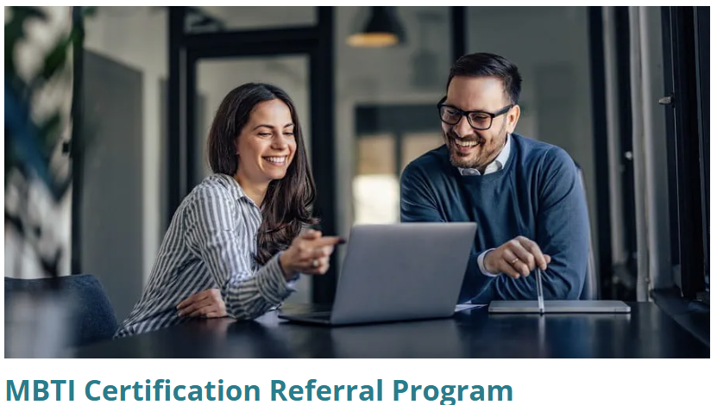
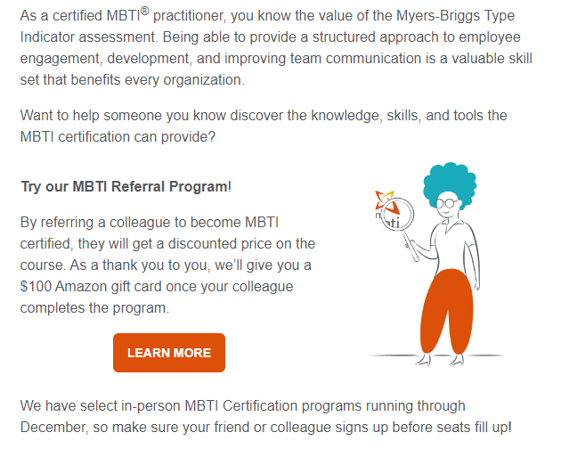
UK Customer Referral Program
🚀Launched Jan 2024
Details:
10% off certification program for prospect
£100 Amazon gift card for practitioner
Assets:
Referral emails
Dedicated Web Page
Once referred, leads go into a nurture series to continue following up
Results of 2024
11 referral forms submitted
6 bookings – mix of Step I, II and SGC
Over £18k revenue generated
Notes:
5 UK = 3 Step I and 1 Step I & II and 1 SGC
1 DACH Step I and II 3,690.00 € excluding VAT – save 290 €. =3,400 €/ £2850
FIRO referral switched off – focus on MBTI

Slide 20
The Personal Impact Report Campaign - Blue Box Practitioners

Slide 21
Promoting the PIR for Talent Development
Campaign Goal:
To increase awareness and adoption of the MBTI Personal Impact Report as a powerful tool for advancing skills development, coaching, productivity, and onboarding within organizations.
Target Audience:
MBTI certified practitioners - not using the PIR report Blue box: ICON - Corporate Consultants & Superstars, Internal Customers - L&D/OD Specialists & MBTI Champions
Notes:
Use Dan's PIR plan – Dan help with the follow up approach (email/content/assets) f/u plan sales

Slide 22
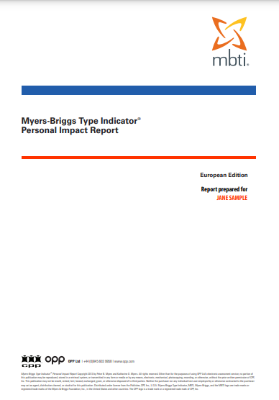
Key Messaging - Customer
Personalized Learning | Create more relevant and impactful learning experiences.
Coaching Accelerator | Equip managers and coaches to enable personalized, effective coaching.
Productivity Driver | Help teams navigate personality differences, streamline collaboration, and improve productivity.
Onboarding Module | Enhance employee onboarding - foster quicker integration and stronger relationships
Developmental Blueprint | Provides a clear path for personalized development over 12-18 months

Slide 23
Channels of Activity Customer
Channel | January | February | March
💻Webinar series | 3 webinar series – 1st in Q1
📧 Email | 4 invite series with marketing nurture f/u and sales outreach (TBC)
💻Website | Homepage banner, events and webinars pages. Dedicated LP
👍Social | LinkedIn promotion – targeted to audience
🔍 External Advertising?? | White paper/Asset utilizing webinar information
Notes:
Marketing fundamentals

Slide 24
Theme for Webinars - Customer
Q1 Activity
Title: Personalized Learning at Scale: Revolutionizing Your Soft Skills Programs Overview: Dive deep into how the PIR transforms traditional soft skills programs by personalizing content to the learner’s personality type. | Key Takeaways: How to tailor communication, leadership, and teamwork training using personality type insights. Actionable examples of transforming workshops into dynamic, personalized learning experiences. Best practices for integrating the report into existing programs for maximum impact.
Webinar 2: A year of talent development with one report [a year’s worth of learning] - One of last two weeks in Feb – works for promo time
Webinar 3: Onboarding Success: How to Use Personality Insights to Accelerate New Employee Integration
Notes:
Add bridge language
Webinar 2: A year of talent development with one report [a year’s worth of learning]
Overview: Learn how you can build out a 12 month learning program using the PIR report to increase scalability with limited resources.
Key Takeaways:
Learn about the various elements contained within the PIR report, including work style, communication style, team style, leadership style, etc.
Explore different blueprints for mapping out a 12 month series of learning based on the PIR insights.
Hear from our experts how they would approach creating these sessions from real world experience, targeting both whole teams and individual sessions.
Webinar 3: Onboarding Success: How to Use Personality Insights to Accelerate New Employee Integration
Overview: Discover how to incorporate the Personal Impact Report into the onboarding process to accelerate relationship building and collaboration among new hires. Will also result in more natural and consistent embedding of the MBTI within an organization.
Key Takeaways:
How to use the report during onboarding to build rapport and understanding between new hires and their teams.
Creating a lunch-and-learn session based on the report for effective team bonding.
Real-world examples of accelerated onboarding processes
Coaching Accelerator & Productivity Driver elements – looking to turn those into assets of some kind to share, possibly one sheet or guide style

Slide 25
Promoting the PIR for Talent Development - Prospects
Campaign Goal:
Educate prospects about the Personal Impact Report and how to leverage its powerful insights for skills development, improved onboarding, personalized learning, and team productivity. The end goal is to get prospects to become MBTI certified to then utilize the PIR report.
Target Audience:
Prospective Blue box

Slide 26
Key Messaging - Prospects
Productivity Driver | Help teams navigate personality differences, streamline collaboration, and improve productivity.
Onboarding Module | Enhance employee onboarding - foster quicker integration and stronger relationships
Personalized Learning at Scale | Provides a clear path for personalized development over 12-18 months

Slide 27
Channels of Activity Prospects or do one calendar for both?
Q1 Activity
Channel | January | February | March
💻Webinar series | 2 webinar series – 1st in Q1
📧 Email | 4 invite series with marketing nurture f/u and sales outreach (TBC)
💻Website | Homepage banner, events and webinars pages. Dedicated LP
👍Social | LinkedIn promotion – targeted to audience
🔍 External Advertising?? | White paper/Asset utilizing webinar information

Slide 28
Theme for Webinars - Prospects
Q1 Activity
Title: Personalized Learning at Scale: Revolutionizing Your Soft Skills Programs Overview: Introduction into how the MBTI, specifically the Personal Impact Report, transforms traditional soft skills programs by personalizing content to the learner’s personality type. CTA: Explore certification options, get certified, connect with a rep to discuss more. | Key Takeaways: Understanding of the various elements within the PIR report. How to tailor communication, leadership, and teamwork training using personality type insights. Actionable examples of transforming workshops into dynamic, personalized learning experiences. Best practices for integrating the report into existing programs for maximum impact.
Webinar 2: Onboarding Success: How to Use Personality Insights to Accelerate New Employee Integration
Notes:
Webinar 2: Onboarding Success: How to Use Personality Insights to Accelerate New Employee Integration
Overview: Discover how incorporating the Personal Impact Report into an onboarding process can accelerate relationship building and collaboration among new hires.
Key Takeaways:
How to use the report during onboarding to build rapport and understanding between new hires and their teams.
Creating a lunch-and-learn session based on the report for effective team bonding.
Real-world examples of accelerated onboarding processes
CTA: explore certification options, get certified, connect with a rep to discuss more

Slide 29
Harnessing the Power of Personality – New year Promo
Goal: To grow certification and increase reasons for sales outreach
Target: Attendees of last Nov's webinar – 71 prospects
Approach: Build on the engagement created from webinar and marketing email nurture. Outlook style email series - CTA – Book a call and take our promotional offer.
Email 1 – Jan 32% click to open rate – SF task assigned
Email 2 Feb, Email 3 Mar
Webinar Promotion/ Engagement
Marketing email nurture
Promo
Sep – Nov
Nov – Dec
Jan - Mar

Slide 30
Sustaining Engagement: Sales Follow-Up and offer of 10 free PIR reports
Discount Details Applies to a possible 6 public courses in Q1 and Self-Guided Certification. Purchase of Step I or Step I & II combined. Book and complete the Step I element and receive 10 free PIR reports worth over £850! Promocode: POPWEB0125 | Promotional Dates From 2nd Jan to 31st Mar.
Sales action – Facilitate the offer and course booking for inbound enquiries – follow-up on SF leads assigned via SF (these will be based on email behaviour).

Slide 31
TKI activity 2025
Notes:
Reduce section down to what's live

Slide 32
3 webinar series
Q1 Activity
Webinar | Registrants | Live Attendees
Difficult Conversations | 852 | 407
Six Steps | 596 | 284
Intergenerational conflict (IG) | 276 | 110
Jason reach out
J+D other things in flight
Want to repeat webinars
3 throughout the year
Generational conflict – other topic we discussed – can we do it this year

Slide 33
Results from last years TKI webinars
Webinar | Registrants | Live Attendees
Difficult Conversations | 852 | 407
Six Steps | 596 | 284
Intergenerational conflict (IG) | 276 | 110
Marketing nurture is now complete - An Outlook style marketing nurture email series sharing resources has been sent – achieved 45% click to open rate
Sales follow-up approach - All the attendees of IG to be added to Salesforce campaign for sales to assess and contact high-value clients with offer.
Notes:
Result from last year webinar
sEngagement still good – first 2 over performed as no comms for long period. Adjust plan going forward – spread comms out.

Slide 34
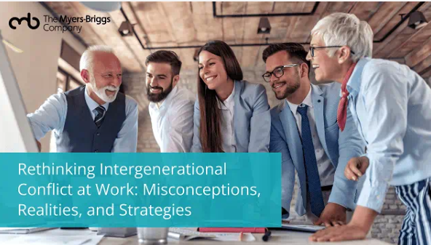
Sustaining Engagement: Sales Follow-Up and offer of free facilitator guide
All the attendees of Intergenerational Conflict webinar to be added to SF campaign for sales to assess and contact high-value clients with offer.
Offer Details For people who purchase 50 TKI reports - we offer a facilitator guide for free. Sales action - Reach out to those appropriate and facilitate the offer.
Coming soon – Discount on TKI course
Supported by a marketing promotional email series – we will offer this audience 25% off our Conflict Management Training with TKI course in March.
Notes:
50 is a goal number, but can be determined by sales rep on case-by-case basis.

Slide 35
Bank Your Budget Email sends - Customers
Q1 Activity
Jan | Feb | Mar | Apr | May | Jun | Jul | Aug | Sep | Oct | Nov | Dec
Local Gov – Email and reminders Gov and Healthcare - |  |  |  | Professional Services (Legal, Accountancy, Mgmt Consultancy) |  |  |  |  |  | All sectors minus ICON and Gov/Health
 |  |  |  |  | Education/Universities

Slide 36
Festival of Work
Q1 Activity
Notes:
Show up to every webinar
Follow-up within certain period of time
Customer feedback
Adopting and pulling through ATD tradeshow game plan
Who goes
Assignment driven
Tight messaging
Clear CTA

Slide 37
Levelling up L&D: How to use type-oriented training for maximum impact

Slide 38
The third in a series of webinars themed on MBTI Certification
Campaign Goal:
To build awareness of MBTI Certification , demonstrate how impactful it can be to individual and group L&D initiatives through skills development, leadership training and coaching. Share how to champion the MBTI in their own organisation.
Target Audience:
Prospects

Slide 39
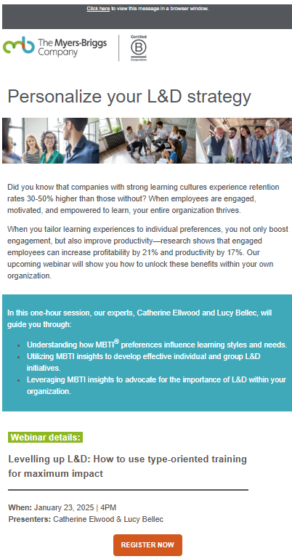
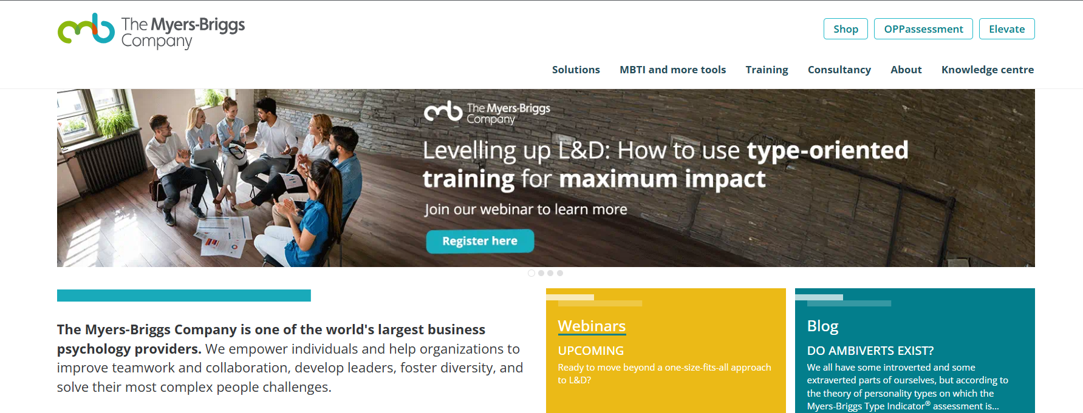
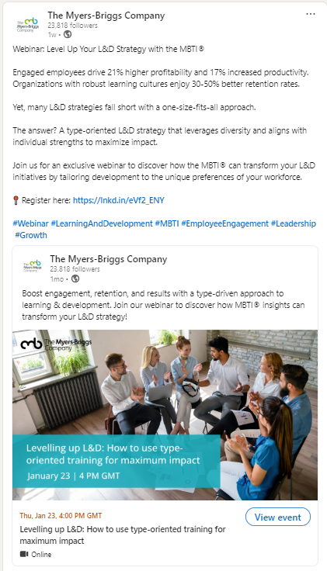
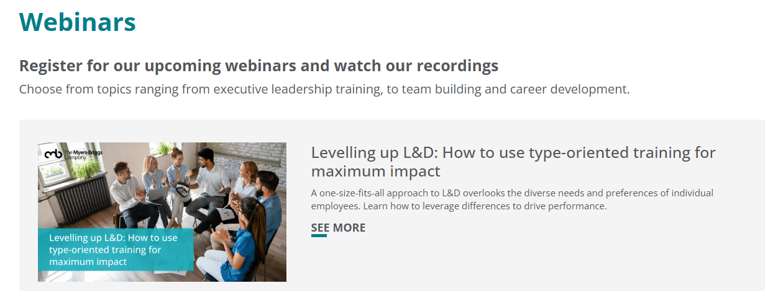
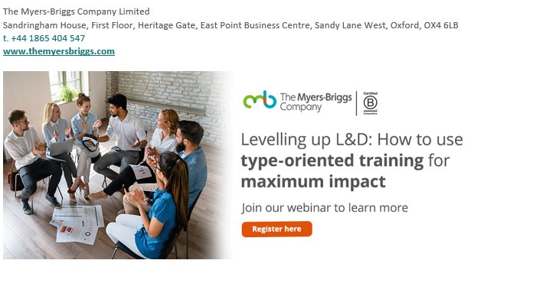
Promotion ran: Nov 24 – Jan 25
💻
📧
👍
30 bookings from LinkedIn
💻
Best performing email invite saw a 65% click to open rate – strong subject line: Ready to level up your L&D game? 🦾
📧
Notes:
Stats and standard FU
Test targeting further resources FU based on behavior
Kaitlyn will confirm next week

Slide 40
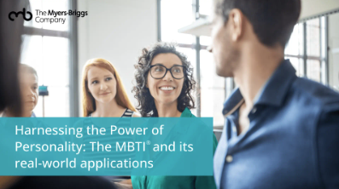
Webinar attendee numbers
Q1 Activity
Webinar | Registrants | Live Attendees
Durable Skills | 198 | 66
The Power of Personality | 209 | 81
Levelling up L&D | 166
Follow up Activity:
Marketing nurture 2/3 email series 24th – 31st Jan
Marketing will follow-up with our standard 3 follow-up emails after the webinar date to all registrants.
Once someone engages with the CTA in the follow up emails they will enter the automated SF process -- adding to campaign and tasks assigned
Notes:
Liane f/U for – agree this week
Work to refocus data pots to bluebox practitioners

Slide 41
Dayna – What we need from you slide

Slide 42
Sales & Marketing Q&A
Notes:
Dan work on talking points – agree monday

Slide 43
Search & Social

Slide 44
Website | Main Competitors | Website Traffic (desktop, Global) | LinkedIn Followers
 | TMBC US + EU | 250,000 | 22,000
https://www.insights.com/ | Insights | 41,500 | 112,000
https://www.everythingdisc.com/ | Everything DiSC | 22,300 | 24,000
https://www.gallup.com/cliftonstrengths | CliftonStrengths | 355,000 | 75,000
https://www.typecoach.com/ | Type Coach | 12,800 | 2,000
https://luminalearning.com/ | Lumina Learning | 4,500 | 11,000
https://www.predictiveindex.com/ | The Predictive Index | 125,000 | 67,000
https://www.thegcindex.com/ | THE GC INDEX | 4,000 | 3,000
 | Other Competitors
https://www.hoganassessments.com/ | Hogan | 41,600 | 37,000
https://talogy.com/en/ | Talogy | 15,000 | 83,000
https://www.profiledynamics.com/ | Profile Dynamics | 1,600 | 1000
https://www.shl.com/ | SHL | 145,000 | 70,000
https://high5test.com/ | High5Test | 183,000 | 2,000
https://www.savilleassessment.com/ | Saville Assessment | 5,700 | 13,000
https://www.eitrainingcompany.com/eq-i/ | EQ-i 2.0 | 4,500 | 5,000

Slide 46
Strategy
Primary Channels: Search (Google Ads & SEO) and LinkedIn (Organic & Paid)
Objective: Drive certification bookings and high-value form fills.

Slide 47
Competitive Landscape in EU
Competitors: Analyze their search and social strategies.
Identify gaps in our LinkedIn and SEO presence.
Leverage insights for innovative campaign ideas.
Focus on differentiators like personalized content and practitioner success stories.

Slide 48
Search: Advertising & SEO
Improve organic traffic by 15% through SEO optimization.
Optimize Google Ads campaigns for lower CPC and higher conversion rates.
Focus on high-impact keywords like 'MBTI Certification' and 'Leadership Development'.
AI SEO optimisation.
Notes:
Benchmarks – website traffic
Targeting customers

Slide 49
LinkedIn
Grow LinkedIn followers by 20%.
Increase engagement rates by 25% through tailored content.
Launch targeted paid campaigns for HR and L&D professionals globally.
Utilize LinkedIn newsletters and groups for community building.
Notes:
Shift in content style – L&D

Slide 50
Execution Plan & KPIs
SEO KPIs: Organic traffic, keyword rankings, site performance metrics.
LinkedIn KPIs: Engagement rates, lead generation, follower growth.
Implementation: Agile sprints for continuous improvement.

Slide 51
ZoomInfo
Reducing Churn
ROI of the campaigns

